Slide 1
OS’22 Project
Milestone 2 Description
Paging, chunk OPER’S & KERNEL heap

Slide 2
Agenda
Logistics
MS2 Quick Guide
MS2 Objective
MS2: 1- PAGE TABLE ENTRIES MANIPULATION
Required Functions
TESTING
MS2: 2- RAM CHUNKS MANIPULATION
Required Functions
BONUS
TESTING
MS2: 3- Kernel Heap
What is new in Kernel Heap?
Required Functions
BONUS
TESING
How to submit?

Slide 3
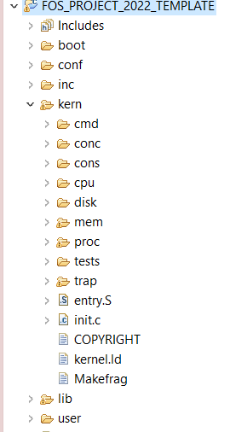




PROJECT BIG PICTURE
inc (.h)
lib (.c)
[MS1]
Dynamic Allocator
user
kern
[MS3]
User Heap
[MS2]
Helper F^{n}s & Kern Heap

Slide 4
Logistics
Startup Code & Changed Files:
Continue on the startup code from MS1.
Before starting in MS2, SELECT ALL in “Changed files” folder, COPY & PASTE (REPLACE ALL) in FOS_CODES/FOS_PROJECT_2022_TEMPLATE/.
Delivery Method: GOOGLE FORMS
It’s FINAL delivery
MUST deliver the required tasks and ENSURE they’re worked correctly
Delivery Dates:
FRIDAY of Week #8 (25/11/2022 @11:59 PM)
Upload your code EARLY as NO EXCEPTION will be accepted.
Support:
The support for teams will be through their MENTORS ONLY (+LECTURER) during the published weekly office hours.

Slide 5
Logistics
ADVICE#1: WORK AS A TEAM
Milestone 2 Functions:
Page Table Entries Manipulations (based on LAB#3) ➔ 4 functions
RAM Chunk Manipulations (based on LAB#3 & LAB#5) ➔ 4 functions
Kernel Heap (based on LAB#5 & MS1) ➔ 5 functions
Average # Functions / Member = 13 / 4 members
ADVICE#2: START immediately!
ADVICE#3: Get BENEFIT from MS1 Functions
Some of the required functions depend on MS1 functions. Make sure they’re correct → CALL THEM
ADVICE#4: MUST read the ppt CAREFULLY
Detailed steps
Helper ready made functions (appendices)
≈ 3 Functions on 3 Weeks

Slide 6
Agenda
Logistics
MS2 Quick Guide
MS2 Objective
MS2: 1- PAGE TABLE ENTRIES MANIPULATION
Required Functions
TESTING
MS2: 2- RAM CHUNKS MANIPULATION
Required Functions
BONUS
TESTING
MS2: 3- Kernel Heap
What is new in Kernel Heap?
Required Functions
BONUS
TESING
How to submit?

Slide 7
Startup Code Quick Guide
Continue on the same template “FOS_PROJECT_2022_Template” from in MS1.
In the Release folder, you will find a folder named with “MS2 Changed Files”. Do the following:
Open this folder.
Select all what exist in “MS2 Changed Files” folder.
Copy them.
Go to “…your directory of fos_cygwin/FOS_CODES/FOS_PROJECT_2022_Template”.
Paste (replace all) in this destination what you copied in step 3.
In eclipse, right click “FOS_PROJECT_2022_Template”, select clean.
Run your code (No errors shall be obtained).
Start in implementing the required functions.

Slide 8
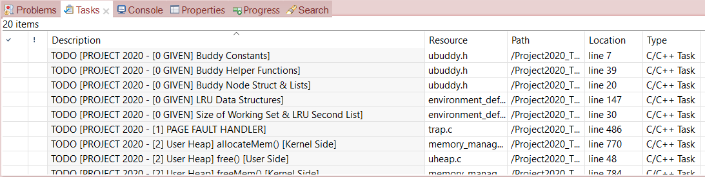
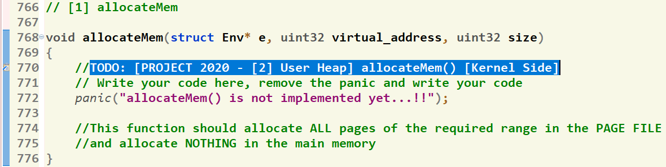
Where should I write the Code?
There’re shortcut links that direct you to the function definition
[1] Click on “Tasks” Tab
[2] Double Click on the required function
GIVEN
REQUIRED
[3] Function body, at which you should write the code
8

Slide 9
Helper Ready Made Functions
Set of ready-made functions are available to help you when writing your solution.
Detailed description can be found in this document.

Slide 10
MS1: Update in insert_sorted_allocList Test
Test of “insert_sorted_allocList” is UPDATED.
Some Modules in MS2 depend on it as KHEAP.
You MUST re-test this function using the updated test to confirm your logic correctness by using the following command: tstlsts insrt
A congratulations message MUST be appeared.

Slide 11
Agenda
Logistics
MS2 Quick Guide
MS2 Objective
MS2: 1- PAGE TABLE ENTRIES MANIPULATION
Required Functions
TESTING
MS2: 2- RAM CHUNKS MANIPULATION
Required Functions
BONUS
TESTING
MS2: 3- Kernel Heap
What is new in Kernel Heap?
Required Functions
BONUS
TESING
How to submit?

Slide 12
MS2 Objective
Add necessary helper functions to manipulate page table entries.
Manipulate RAM chunks (e.g. copy chunk, share chunks, etc.)
Implement kernel heap (using the dynamic allocator).

Slide 13
Agenda
Logistics
MS2 Quick Guide
MS2 Objective
MS2: 1- PAGE TABLE ENTRIES MANIPULATION
Required Functions
TESTING
MS2: 2- RAM CHUNKS MANIPULATION
Required Functions
BONUS
TESTING
MS2: 3- Kernel Heap
What is new in Kernel Heap?
Required Functions
BONUS
TESING
How to submit?

Slide 14
MS2: 1- Page Table Entries Manipulation
The main functions required by MS2 to handle “Page Table Entries” are:
# | Function | File
1 | pt_clear_page_table_entry | All essential declarations in: Kern/mem/paging_helpers.c Functions definitions TO DO in: Kern/mem/paging_helpers.c
2 | pt_set_page_permissions
3 | pt_get_page_permissions
4 | virtual_to_physical
PTE:
Page Frame Number
(Physical Page Number)
Free
(OS)
0
PS
D
A
PCD
PWT
U
W
P
31-12
11-9
8
7
6
5
4
3
2
1
0

Slide 15
MS2: 1- Page Table Entries Manipulation
Table Entry:
The “Present” bit:
P==0: Page is invalid and a reference will cause page fault
P==1: Page frame number is valid and MMU is allowed to proceed with translation
The “Writable” bit:
W==0: Page is read-only and cannot be written.
W==1: Page can be written
The “Accessed” bit (called “Used”):
A==0: Page has not been accessed (or used) since last time software set A→0
A==1: Page has been accessed (or used) since last time software set A→0
The “Dirty” bit (called “Modified”):
D==0: Page has not been modified (written) since PTE was loaded
D==1: Page has changed since PTE was loaded
Physical Frame Number
Free
(OS)
0
PS
D
A
PCD
PWT
U
W
P
31-12
11-9
8
7
6
5
4
3
2
1
0

Slide 16
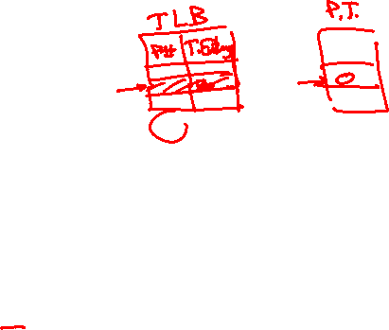
MS2: Page Table Entries Manipulation 1- pt_clear_page_table_entry
Function Declaration:
void pt_clear_page_table_entry(uint32* page_directory, uint32 va);
Function Role:
This function shall set the entry of the given page inside the page table to NULL. This indicates that the page is no longer exists in the memory.
If the given va not exist & has no page table, panic with an error message “Invalid va” since the table shall be exist.
By the end of the function, Invalidate the cache memory (TLB) to refresh the cache by calling tlb_invalidate as follows: tlb_invalidate((void *)NULL, (void *)va);
NOTE: PANIC is a ready function you can call as cprintf. The difference is that panic stops the execution which means that something occurred wrong.
Example: panic(“your message”);

Slide 17
MS2: Page Table Entries Manipulation 2- pt_set_page_permissions
Function Declaration:
void pt_set_page_permissions(uint32* page_directory, uint32 va, uint32 permissions_to_set, uint32 permissions_to_clear);
Function Role:
This function sets the permissions given by “permissions_to_set” to “1” in the page table entry of the given page (va), and clears the permissions given by “permissions_to_clear”.
If the given va not exist & has no page table, panic with an error message “Invalid va” since the table shall be exist.
By the end of the function, Invalidate the cache memory (TLB) to refresh the cache by calling tlb_invalidate as follows: tlb_invalidate((void *)NULL, (void *)va);

Slide 18

MS2: Page Table Entries Manipulation 3- pt_get_page_permissions
Function Declaration:
int pt_get_page_permissions(uint32* page_directory, uint32 va);
Function Role:
This function takes a page directory pointer and a virtual address to return ALL its permissions bits.
If the page table of the given va exist, return its corresponding permissions (the least significant 12 bits).
If the given va has no page table, return -1.

Slide 19
MS2: Page Table Entries Manipulation 4- virtual_to_physical
Function Declaration:
int virtual_to_physical(uint32* page_directory, uint32 va);
Function Role:
This function takes a page directory pointer and a va. Then, it shall return its corresponding physical address.
If the page table of the given va exist, return its corresponding physical address mapped to it.
If the given va has no page table, return -1.

Slide 20

MS2: Page Table Entries Manipulation Testing
Test each function in MS1 independently in a FRESH SEPARATE RUN.
The time limit of each individual test: max of 10 sec / each
During your solution, don't change any file EXCEPT those who contain "TODO“.
# | Function | Test
1.1 | pt_clear_page_table_entry | FOS> tstpg clear1
2.1 | pt_set_page_permissions | FOS> tstpg scperm1
3 | pt_get_page_permissions | FOS> tstpg getperm
4 | virtual_to_physical | FOS> tstpg v2p
"Congratulations!! test [TEST NAME] completed successfully.”
To ensure the success of a test a congratulations message like this MUST be appeared without any ERROR messages or PANICs.

Slide 21
MS2: Page Table Entries Manipulation Testing (Cont.)
To check page table entries manipulation for invalid addresses. Use the following tests:
# | Function | Test
1.2 | pt_clear_page_table_entry | FOS> tstpg clear2
2.2 | pt_set_page_permissions | FOS> tstpg scperm2
NO CONGRATULATIONS HERE.
YOUR PANIC message MUST be appeared with the above tests to ensure the correctness of your logic in case of invalid virtual addresses are given.

Slide 22
Agenda
Logistics
MS2 Quick Guide
MS2 Objective
MS2: 1- PAGE TABLE ENTRIES MANIPULATION
Required Functions
TESTING
MS2: 2- RAM CHUNKS MANIPULATION
Required Functions
BONUS
TESTING
MS2: 3- Kernel Heap
What is new in Kernel Heap?
Required Functions
BONUS
TESING
How to submit?

Slide 23
MS2: 2- RAM chunks Manipulation
The main functions required by MS2 to handle “RAM chunks” are:
# | Function | File
1 | cut_paste_pages | All essential declarations in: Kern/mem/chunk_operations.h Functions definitions TO DO in: Kern/mem/chunk_operations.c
2 | copy_paste_chunk
3 | share_chunk
4 | allocate_chunk
MS2 BONUS 1 | calculate_allocated_space
MS2 BONUS 2 | calculate_required_frames

Slide 24
MS2: 2- RAM chunks Manipulation
RAM chunks” is specified by:
Start virtual address
Size (in bytes OR number of pages)
Not necessarily aligned on page boundaries
Hint: can use ROUNDDOWN/ROUNDUP macros to align the addresses (Check appendix)
ProcX VM
.
.
.
4
3
Size
2
Start_va
1
0

Slide 25
MS2: RAM chunks Manipulation 1- cut_paste_pages
Function Declaration:
int cut_paste_pages(uint32* page_directory, uint32 source_va, uint32 dest_va, uint32 num_of_pages);
Function Role:
This function should cut-paste the given <num of pages> from <source va> to <dest va> in the given address space <page_directory>
Ranges DO NOT overlapped.
If ANY of the destination pages exists, deny the entire process and return -1. Otherwise, cut-paste the required pages and return 0.
If the page table at any destination page in the range is not exist, it should create it.
ALL 12 permission bits of the destination should be TYPICAL to those of the source.
The given address(es) may be not aligned on 4 KB.

Slide 26

MS2: RAM chunks Manipulation 2- copy_paste_chunk
Function Declaration:
int copy_paste_chunk(uint32* page_directory, uint32 source_va, uint32 dest_va, uint32 size)
Function Role:
This function should copy (not share) the given virtual range [<source_va>, <source_va> + <size>) to the destination range [<dest_va>, <dest_va> + <size>) in the given address space <page_directory>.
Ranges DO NOT overlapped.
If ANY of the destination pages exists with READ ONLY permission, deny the entire process and return -1.
If the page table at any destination page in the range is not exist, it should create it
If ANY of the destination pages doesn't exist, create it with the following permissions then copy. Otherwise, just copy!
WRITABLE permission
USER/SUPERVISOR permission must be SAME as the one of the source
The given range(s) may be not aligned on 4 KB

Slide 27
MS2: RAM chunks Manipulation 3- share_chunk
Function Declaration:
int share_chunk(uint32* page_directory, uint32 source_va,uint32 dest_va, uint32 size, uint32 perms)
Function Role:
This function should share the given virtual range [<source_va>, <source_va> + <size>) to the destination range [<dest_va>, <dest_va> + <size>) in the given address space <page_directory>.
Ranges DO NOT overlapped.
If ANY of the destination pages exists, deny the entire process and return -1. Otherwise, share the required range and return 0.
If the page table at any destination page in the range is not exist, it should create it.
It should set the permissions of the second range by the given perms.
The given range(s) may be not aligned on 4 KB

Slide 28

MS2: RAM chunks Manipulation 4- allocate_chunk
Function Declaration:
int allocate_chunk(uint32* page_directory, uint32 va, uint32 size, uint32 perms)
Function Role:
This function should allocate the given virtual range [<va>, <va> + <size>) in the given address space <page_directory> with the given permissions <perms>.
If ANY of the destination pages exists, deny the entire process and return -1. Otherwise, allocate the required range and return 0.
If the page table at any destination page in the range is not exist, it should create it.
Allocation should be aligned on page boundary. However, the given range may be not aligned.

Slide 29

MS2: RAM chunks Manipulation Bonus Bonus 1- calculate_allocated_space
Function Declaration:
void calculate_allocated_space(uint32* page_directory, uint32 sva, uint32 eva, uint32 *num_tables, uint32 *num_pages)
Function Role:
This function should calculate the number of the allocated tables and the allocated pages for a given range [sva, eva).
It shall count the number of allocated tables in the given “num_tables” parameter
It shall count the number of allocated pages in the given “num_ pages” parameter

Slide 30

MS2: RAM chunks Manipulation Bonus Bonus 2- calculate_required_frames
Function Declaration:
uint32 calculate_required_frames(uint32* page_directory, uint32 sva, uint32 size)
Function Role:
This function should calculate the required number of pages for allocating and mapping the given range [start va, start va + size) (for the pages themselves and for the page tables required for mapping).
NOTE: pages and/or page tables that are already exist in the range SHOULD NOT be counted.
The given range(s) may be not aligned on 4 KB.

Slide 31
MS2: RAM chunks Manipulation Testing
Test each function in MS1 independently in a FRESH SEPARATE RUN.
The time limit of each individual test: max of 1 min / each
During your solution, don't change any file EXCEPT those who contain "TODO“.
# | Function | Test
1 | cut_paste_pages | FOS> tstchunks cutpaste
2 | copy_paste_chunk | FOS> tstchunks copypaste
3 | share_chunk | FOS> tstchunks share
4 | allocate_chunk | FOS> tstchunks allocate
MS2 BONUS 1 | calculate_allocated_space | FOS> tstchunks allocated_space
MS2 BONUS 2 | calculate_required_frames | FOS> tstchunks required_space
"Congratulations!! test [TEST NAME] completed successfully.”
To ensure the success of a test a congratulations message like this MUST be appeared without any ERROR messages or PANICs.

Slide 32
Agenda
Logistics
MS2 Quick Guide
MS2 Objective
MS2: 1- PAGE TABLE ENTRIES MANIPULATION
Required Functions
TESTING
MS2: 2- RAM CHUNKS MANIPULATION
Required Functions
BONUS
TESTING
MS2: 3- Kernel Heap
What is new in Kernel Heap?
Required Functions
BONUS
TESING
How to submit?

Slide 33
MS2: 3- Kernel Heap
The main functions required by MS2 to handle “Kernel Heap” are:
# | Function | File
1 | initialize_dyn_block_system | All essential declarations in: Kern/mem/kheap.h Functions definitions TO DO in: Kern/mem/kheap.c
2 | kmalloc (using FIRST & BEST fit)
3 | kfree
4 | kheap_virtual_address
5 | kheap_physical_address
MS2 BONUS 3 | Kmalloc (using NEXT fit)
MS2 BONUS 4 | Krealloc (using BEST fit)

Slide 34
MS2: 3- Kernel Heap
IMPORTANT NOTE
Before starting in the KHEAP functions, you MUST DO the following:
- Go to 'inc/memlayout.h' and set USE_KHEAP by 1
- Go to 'inc/dynamic_allocator.h' and set STATIC_MEMBLOCK_ALLOC by 0

Slide 35

MS2: Kernel Heap – What is new?
Current:
Kernel is one-to-one mapped to 256 MB RAM
Kernel can’t directly access beyond 256 MB RAM
Problem:
Virtual Memory
4 GB
Physical Memory
FOS
256 MB
RAM
UP TO 4 GB
KERNEL_BASE
256 MB
0

Slide 36


MS2: Kernel Heap – What is new? (Cont.)
Example:
Kernel can’t directly access beyond 256 MB RAM
Because it is NOT
valid VA..
New_PT1
VA = KERNEL_BASE +512 MB!!
.
.
.
256 MB
New PT0
VA = KERNEL_BASE + 20 KB
New DIR
VA = KERNEL_BASE + 16 KB
PA = 512 MB
New PT1
Frame#131,072
.
.
.
KERNEL_BASE
PA = 20 KB
New PT0
Frame#5
PA = 16 KB
New DIR
Frame#4
Program’s Virtual Memory
PA = 0
RAM

Slide 37

MS2: Kernel Heap – What is new?
Solution:
Kernel Heap for dynamic allocations (No 1-1 map)
KERNEL’S TABLES
PTR_PAGE_DIRECTORY
PT#984
1023
Empty
984
Kernel Heap
500000
0
0
F#4
New PT0
VA = KHS + 4K
984
0
0
New DIR
VA = KHS
PA = 2 GB
NEW PT0
Frame#500,000
Index of Kernel Heap PT
KERNEL_BASE
.
.
.
.
.
.
PA = 16 KB
New DIR
Frame#4
KHS = KERNEL_HEAP_START
RAM
Program’s Virtual Memory

Slide 38

MS2: Kernel Heap – What is new? (Cont.)
KERNEL_HEAP_MAX
4 GB
KHEAP
KERNEL_HEAP_START
Kernel Heap lies at the end of the virtual space
256 MB
USTACKTOP
USTACKBOTTOM

Slide 39

MS2: Kernel Heap
1- initialize_dyn_block_system
In MS1, we didn’t have dynamic allocation. So, we created MemBlockNodes statically with a constant size.
Now, we have a kernel heap which can be utilized to allocate arrays in it dynamically.
Kernel Heap
MAX_MEM_BLOCK_CNT
MemBlockNodes
0 | 1 | 2 | …. |  | 100
…. | KH Pages
KERNEL_BASE
AvailableMemBlocksList
.
.
.
Program’s Virtual Memory

Slide 40
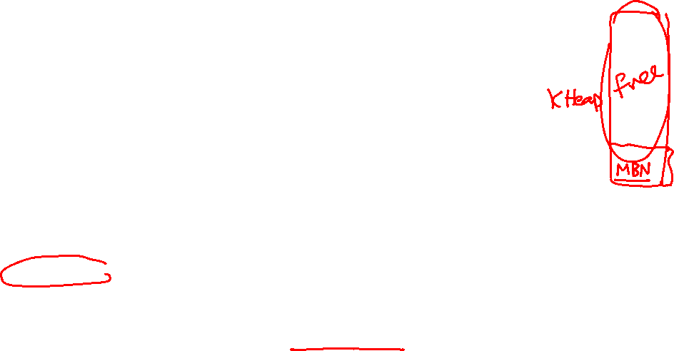
MS2: Kernel Heap
1- initialize_dyn_block_system
Function Declaration:
void initialize_dyn_block_system();
Function Role:
It initializes the dynamic blocking system by allocating MemBlockNodes array dynamically as follows:
Initialize two lists (AllocMemBlocksList & FreeMemBlocksList) [Hint: use LIST_INIT()]
Dynamically allocate the array of MemBlockNodes. Remember to:
1. Set the global variable “MAX_MEM_BLOCK_CNT” with the number of pages in the kernel heap.
2. Allocate the required space for the MemBlockNodes array. Allocation should be aligned on PAGE boundary (4KB).
HINT: you can use alloc_chunk(...) function
Initialize AvailableMemBlocksList by filling it with the MemBlockNodes
HINT: You can get BENEFIT from MS1 Functions
Insert a new MemBlock with the remaining heap size into the FreeMemBlocksList

Slide 41

MS2: Kernel Heap
2 & 3- kmalloc/kfree
Kmalloc(): dynamically allocate space
Kfree(): delete a previously allocated space
Kfree()
Remove ALL Pages BUT NOT Tables
kmalloc()
ALL Pages Created in Memory
KERNEL HEAP
RAM
MemBlock Nodes

Slide 42
MS2: Kernel Heap
2 & 3- kmalloc/kfree (Cont.)
Allocate pages on 4KB granularity
.
.
.
ptr3 = kmalloc (3 KB)
ptr3
3 KB
ptr2 = kmalloc (1 KB)
ptr2
1 KB
2 KB
4 KB
ptr1 = kmalloc (6 KB)
ptr1
MemBlockNodes
.
.
.
KERNEL_HEAP_START

Slide 43

MS2: Kernel Heap
2 & 3- kmalloc/kfree (Cont.)
.
.
.
KERNEL_HEAP_MAX
2 MB
FIRST FIT Strategy
.
.
.
ptr4 = kmalloc (2 MB)
2 MB
ptr4
1 MB
3 MB
4 MB
ptr2 = kmalloc (3 MB)
ptr2
2 MB
ptr3 = kmalloc(1 MB)
ptr3
1 MB
3 MB
ptr1 = kmalloc (1 MB)
ptr1
1 MB
4 MB
MemBlockNodes
In kmalloc, you need to check which strategy is currently selected to apply its code using the given functions: isKHeapPlacementStrategyFIRSTFIT(), isKHeapPlacementStrategyBESTFIT(), …
KERNEL_HEAP_START
.
.
.

Slide 44
MS2: Kernel Heap
2 & 3- kmalloc/kfree (Cont.)
.
.
.
BEST FIT Strategy
KERNEL_HEAP_MAX
.
.
.
1 MB
ptr3 = kmalloc (1 MB)
ptr3
1 MB
3 MB
4 MB
ptr2 = kmalloc (3 MB)
ptr2
2 MB
ptr4 = kmalloc (2 MB)
2 MB
ptr4
3 MB
ptr1 = kmalloc (1 MB)
ptr1
1 MB
MemBlockNodes
KERNEL_HEAP_START
.
.
.

Slide 45
MS2: Kernel Heap
4 & 5- kheap_physical_address/kheap_virtual_address
kheap_physical_address(): find physical address of the given kernel virtual address
kheap_virtual_address(): find kernel virtual address of the given physical one
IMP: Both MUST be Efficient ~O(1)
kheap_physical_address()
Get pa of the given va
kheap_virtual_address()
Get va of the given pa
KERNEL HEAP
RAM
pa
pa
va
va
MemBlock Nodes

Slide 46
MS2: Kernel Heap BONUS
Bonus 3- kmalloc using NEXT FIT strategy
NEXT FIT Strategy
4 GB
ptr4=kmalloc (2 MB)
4 KB
KERNEL_HEAP_MAX
2 MB
ptr4
ptr3=kmalloc (1 MB)
ptr3
1 MB
3 MB
ptr2=kmalloc (3 MB)
ptr2
ptr1=kmalloc (1 MB)
ptr1
1 MB
1 MB
ptr5=kmalloc (1 MB)
2 MB
2 MB
x
1 MB
kfree(x)
ptr5
4 MB
MemBlockNodes
.
.
.
KERNEL_HEAP_START
.
.
.

Slide 47
MS2: Kernel Heap BONUS
Bonus 4- krealloc using FIRST FIT strategy
Kernel Realloc
Attempts to resize the allocated space at given virtual address to "new size" bytes, possibly moving it in the heap.
If successful, returns the new virtual address, in which case the old virtual address must no longer be accessed.
On failure, returns a null pointer, and the old virtual address remains valid.
A call with virtual_address = null is equivalent to kmalloc()
A call with new_size = zero is equivalent to kfree()

Slide 48
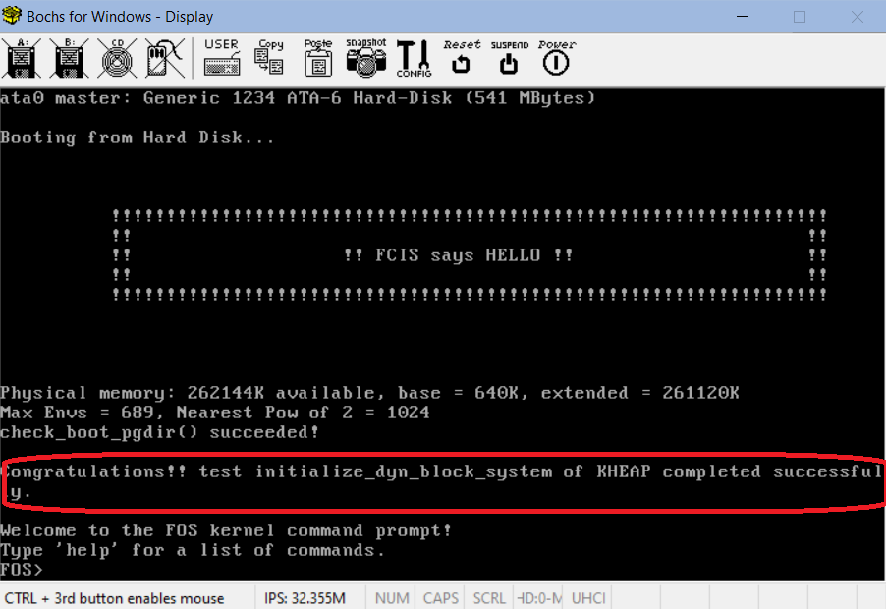

MS2: Kernel Heap Testing
Test each function in MS1 independently in a FRESH SEPARATE RUN.
The time limit of each individual test: max of 30 sec / each
Before testing any of the kheap functions:
Go to 'inc/memlayout.h' and set USE_KHEAP by 1
Go to 'inc/dynamic_allocator.h' and set STATIC_MEMBLOCK_ALLOC by 0
# | Function | Test
1 | initialize_dyn_block_system | It is tested automatically with the FOS startup. To ensure your code correctness, run your code and then a congratulations message MUST be appeared at the beginning as follows…

Slide 49

DON’T FORGET to test each function in MS1 independently in a FRESH SEPARATE RUN.
# | Function | Test
2 | Kmalloc using FIRST FIT | Test 1: FOS> tstkheap ff kmalloc 1 Test 2: FOS> tstkheap ff kmalloc 2 //Depend on kfree Test 3: FOS> tstkheap ff kmalloc 3 //Depend on kfree
3 | Kmalloc using BEST FIT | Test 1: FOS> tstkheap bf kmalloc 1 Test 2: FOS> tstkheap bf kmalloc 2 //Depend on kfree Test 3: FOS> tstkheap bf kmalloc 3 //Depend on kfree
4 | kfree | Test 1: FOS> tstkheap ff kfree Test 2: FOS> tstkheap bf kfree Test 3 (BONUS): FOS> tstkheap nf kfree
5 | kheap_virtual_address | Test 1: FOS> tstkheap ff kvirtaddr Test 2: FOS> tstkheap bf kvirtaddr Test 3 (BONUS): FOS> tstkheap nf kvirtaddr
6 | kheap_physical_address | Test 1: FOS> tstkheap ff kphysaddr Test 2: FOS> tstkheap bf kphysaddr Test 3 (BONUS): FOS> tstkheap nf kphysaddr
MS2 BONUS 3 | Kmalloc (using NEXT fit) | Test 1: FOS> tstkheap nf kmalloc 1 Test 2: FOS> tstkheap nf kmalloc 2
MS2 BONUS 4 | Krealloc (using BEST fit) | Test 1: FOS> tstkheap BF krealloc
"Congratulations!! test [TEST NAME] completed successfully.”
To ensure the success of a test a congratulations message like this MUST be appeared without any ERROR messages or PANICs.

Slide 50
MS2: Kernel Heap Testing
Dependency Graph:
Dynamic Allocator
Test initialize
Test kmalloc 1
Test kfree
Test kheap virtual addr.
Test kheap physical addr.
Test kmalloc 2
Test kmalloc 3

Slide 51
Agenda
Logistics
MS2 Quick Guide
MS2 Objective
MS2: 1- PAGE TABLE ENTRIES MANIPULATION
Required Functions
TESTING
MS2: 2- RAM CHUNKS MANIPULATION
Required Functions
BONUS
TESTING
MS2: 3- Kernel Heap
What is new in Kernel Heap?
Required Functions
BONUS
TESING
How to submit?

Slide 52

Submission Rules
Read the following instructions as the code correction is done AUTOMATICALLY. Any violation in these rules will lead to 0 and nothing in this case couldn’t happened.
First ensure the following that (READ CAREFULLY):
You tested each function in a FRESH RUN and a congratulations message have been appeared.
You submitted BEFORE the deadline by several hours to AVOID any internet problems.
DEADLINE: FRIDAY of Week #8 (25/11/2022 @11:59 PM)
ONLY ONE person from the team shall submit the code.
The TEAM # MUST BE CORRECT.
NO DELAYED submissions WILL BE ACCEPTED.
NO CODE with errors WILL BE CORRECTED. So, CLEAN & RUN your project several times before your submission.
DON’T take the FORM LINK FROM ANYONE. OPEN the form from its LINK HERE ONLY. Otherwise, your submission is AUTOMATICALLY CANCELLED by GOOGLE.
You MUST RECEIVE A MAIL FROM GOOGLE with your submission after clicking submit. If nothing received, re-submit again to consider your submission.

Slide 53

Submission Steps
STEPS to SUBMIT:
Clean & run your code the last time to ensure that there are any errors.
Open the form from HERE.
Fill your team’s info .. Any wrong information will cancel your submission, revise them well.
Copy ALL the code in the kern/mem/paging_helpers.c file by (CTRL + A) & PASTE it in the “paging_helpers.c” part.
Copy ALL the code in the kern/mem/chunk_operations.c file by (CTRL + A) & PASTE it in the “chunk_operations.c” part.
Copy ALL the code in the kern/mem/kheap.c file by (CTRL + A) & PASTE it in the “kheap.c” part.
CLICK ON SUBMIT.
You MUST RECEIVE A MAIL from GOOGLE with your submission, otherwise re-submit again.
Submission ISSUE
After CLICKING submit, if error message with “Submission is too long” is appeared.
Resolve it by doing the following.

Slide 54
Thank you for your care…
Enjoy making your own FOS ☺

